Slide 1


SpaceX Falcon9
First Stage
Landing Prediction
Name: Nalin Malla
Date: 2023-12-03

Slide 2

Outline
Executive Summary
Introduction
Methodology
Results
Conclusion

Slide 3
Executive Summary
This project aims to understand how SpaceX a market leading aerospace company is able to gain competitive edge by significantly reducing their per flight cost using proprietary technologies which allow the first stage of their Falcon9 rocket to land.
We also choose the best Machine Learning prediction models used to predict the success of Falcon9 launch. This can be useful for SpaceX competitors if they want to bid against SpaceX for a rocket launch.
Throughout the duration of this project I performed various activities such as: Data Collect, Data Wrangling, Exploratory Data Analysis, Feature Engineering, Data Visualization, Dashboard creation, Predictive Analysis and Documentation.
The experience from this project has provided valuable insights into the nuances of data science methodology. The culmination of these efforts has led to the growth in my technical skills.

Slide 4
Introduction
Project background and context:
This project was done for the fulfillment of "IBM: Applied Data Science Capstone” certification.
SpaceX is an market leading Aerospace company which has dominated the market due to their proprietary technology which allow the first stage of their Falcon 9 rocket to land.
This allows the first stage of the rocket to be reused significantly reducing their cost.
SpaceX advertises Falcon 9 rocket launches on its website with a cost of 62 million dollars; other providers cost upwards of 165 million dollars each.
Problems you want to find answers:
How are various variables related to mission success i.e. successful landing of first stage?
Which factors influence success and there signification?
Which Machine Learning Prediction model is the best for predicting the success of Falcon 9 rockets?

Slide 5

Section 1

Slide 6
Methodology
During this project I performed the following operations:
Data collection:
Data was collected via the SpaceX APIs and webscraping the wikipage of spacex falcone rocekts.
Perform data wrangling:
Here, I mainly mapped mission outcomes of various categories like. True ASDS, True RTLS, etc into clear binary value of 0 & 1 for machine learning models and also made data analysis easier.
Standardization
Feature Engineering using One Hot Encoding

Slide 7
Perform exploratory data analysis (EDA) using visualization and SQL:
To better understand the data.
To identify patterns and relationship between various variables
Perform interactive visual analytics using Folium and Plotly Dash:
To understand relationship between various variables
To gain insight on landing sites using Geospatial maps.
Perform predictive analysis using classification models:
Tested different classification models with various parameter value using GridSearchCV to find:
The best parameters for each models.
The best models among them.

Slide 8
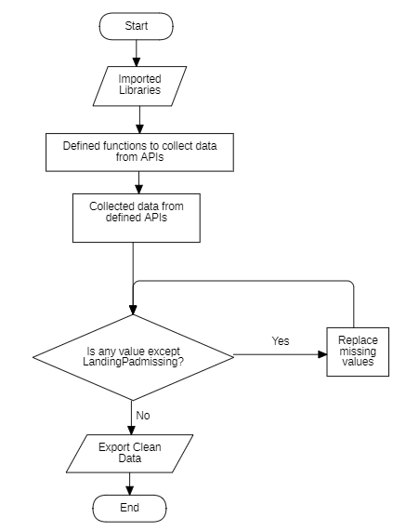
Data Collection
The following REST APIs were used:
https://api.spacexdata.com/v4/launches/past
https://api.spacexdata.com/v4/cores/
https://api.spacexdata.com/v4/payloads/
https://api.spacexdata.com/v4/launchpads/
https://api.spacexdata.com/v4/rockets/
The Jupyter notebook used for data collection is:
https://github.com/NalinMalla/SpaceX-Falcon9-Cost-Predictor/blob/main/1.1.%20Data-collection-api.ipynb

Slide 9
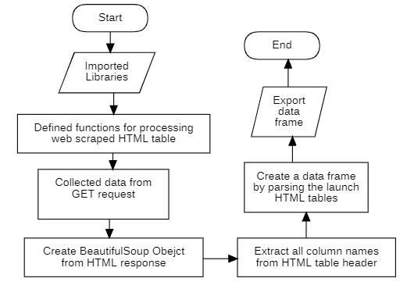
Data Collection - Scraping
The following webpage was used for web scraping:
https://en.wikipedia.org/w/index.php?title=List_of_Falcon_9_and_Falcon_Heavy_launches&oldid=1027686922
The Jupyter notebook used for Web scraping is:
https://github.com/NalinMalla/SpaceX-Falcon9-Cost-Predictor/blob/main/1.2.%20Webscraping.ipynb

Slide 10
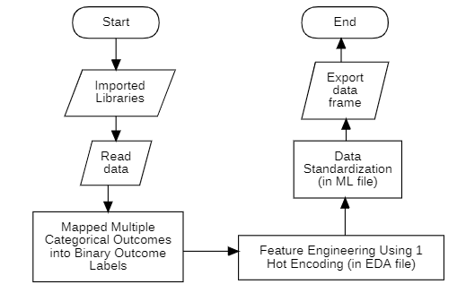
Data Wrangling
The Jupyter notebooks used for Data Wrangling are:
https://github.com/NalinMalla/SpaceX-Falcon9-Cost-Predictor/blob/main/1.3.%20Data%20wrangling.ipynb
For Feature Engineering:
https://github.com/NalinMalla/SpaceX-Falcon9-Cost-Predictor/blob/main/2.2.%20EDA-dataviz.ipynb
For Data Standardization:
https://github.com/NalinMalla/SpaceX-Falcon9-Cost-Predictor/blob/main/4.%20Machine_Learning_Prediction.ipynb

Slide 11
EDA with Data Visualization
Charts which were Used for EDA with Data Visualization as follows:
Scatter & Line Plot: For showing correlation
Bar graph: For comparison of magnitude
Pie Chart: For representing variable shares of a whole.
The Jupyter notebook used for EDA with Data Visualization is:
https://github.com/NalinMalla/SpaceX-Falcon9-Cost-Predictor/blob/main/2.2.%20EDA-dataviz.ipynb

Slide 12
EDA with SQL
The following SQL queries were performed:
Selecting unique values using DISTINCT
Using aggregate function like SUM, AVG, COUNT to get basic statistics.
Using LIKE for String comparison
Subqueries and Grouping
Limiting Outcomes
Add the GitHub URL of your completed EDA with SQL notebook, as an external reference and peer-review purpose
The Jupyter notebook used for EDA with SQL is:
https://github.com/NalinMalla/SpaceX-Falcon9-Cost-Predictor/blob/main/2.1.%20EDA-SQLite.ipynb

Slide 13
Build an Interactive Map with Folium
The following operations were performed:
Marked all launch sites on a map using:
folium.Circle()
folium.map.Marker()
Added colored marks for success/failed launches on each launch site using:
folium.plugins.MarkerCluster
Added polyline between a launch site and coastline near it using:
folium.plugins.MousePosition
folium.features.DivIcon
folium.PolyLine
The Jupyter notebook used for Interactive Map is:
https://github.com/NalinMalla/SpaceX-Falcon9-Cost-Predictor/blob/main/3.1.%20Interactive-Viz-Geo-Site_location.ipynb

Slide 14
Build a Dashboard with Plotly Dash
The following operations were performed:
Created dash app basic layout which included:
Title using html.H1()
Dropdown Input for launch sites using dcc.Dropdown()
Pie Chart to show the successful launch rates of landing sites using dcc.Graph() and px.pie()
A range slider input for payload range using dcc.RangeSlider()
Scatter Plot to show the correlation between payload and launch success using dcc.Graph() and px.scatter()
Add a callback function for `site-dropdown` as input, `success-pie-chart` as output.
Add a callback function for `site-dropdown` and `payload-slider` as inputs, `success-payload-scatter-chart` as output.
The Jupyter notebook used for Dashboard App is:
https://github.com/NalinMalla/SpaceX-Falcon9-Cost-Predictor/blob/main/3.2.%20Spacex_Dash_App.py

Slide 15
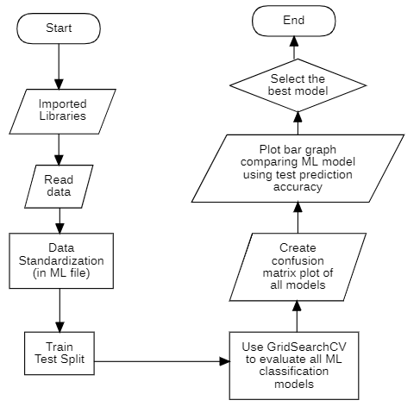
Predictive Analysis (Classification)
The Jupyter notebook used for Predictive Analysis is:
https://github.com/NalinMalla/SpaceX-Falcon9-Cost-Predictor/blob/main/4.%20Machine_Learning_Prediction.ipynb

Slide 16
Results
Exploratory data analysis results
Interactive analytics demo in screenshots
Predictive analysis results

Slide 17

Section 2

Slide 18
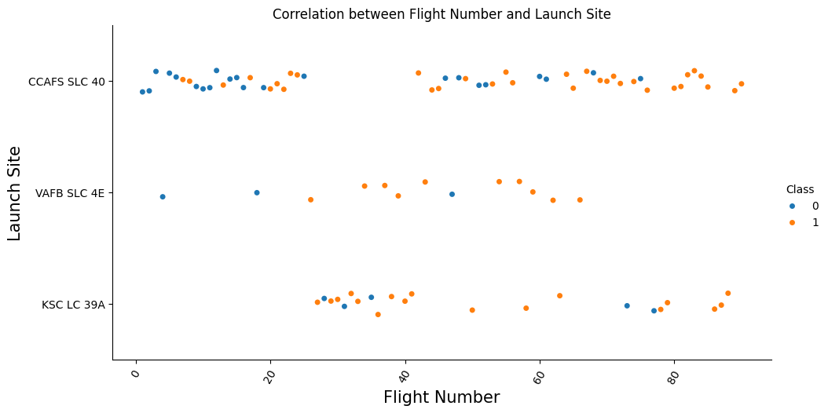
Flight Number vs. Launch Site
Launch Site which are:
Used Most Frequently: CCAFS SLC 40
Used Least Frequently: VAFB SLC 4E
Newly Used: KSC LC 39A
Recently Unused: VAFB SLC 4E

Slide 19
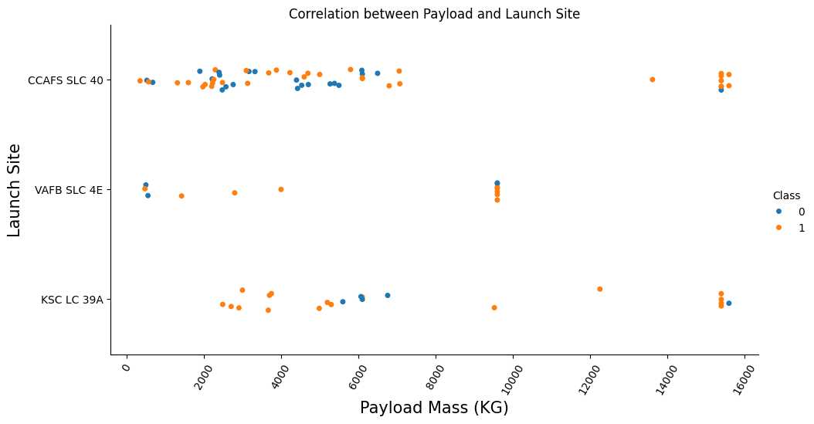
Payload vs. Launch Site
Launch Site which are used for:
Heavy & Light Payloads
CCAFS SLC 40
KSC LC 39A
Only Light Payloads (Less than 10000kg):
VAFB SLC 4E

Slide 20
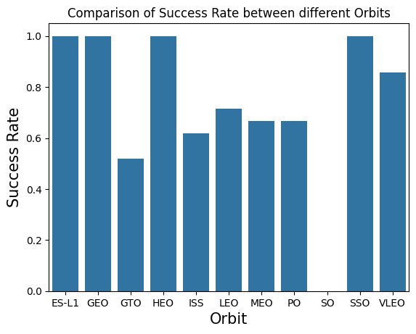
Success Rate vs. Orbit Type
Most Successful Orbit Type: VLEO
Success Rate: 85.7%
No. of flights: 14 (3rd highest)
Unusable Orbit Data (Distorted due to low number of flights):
ES-L1 (1 flight)
GEO (1 flight)
HEO (1 flight)
SO (1 flight)
SSO (5 flights)

Slide 21
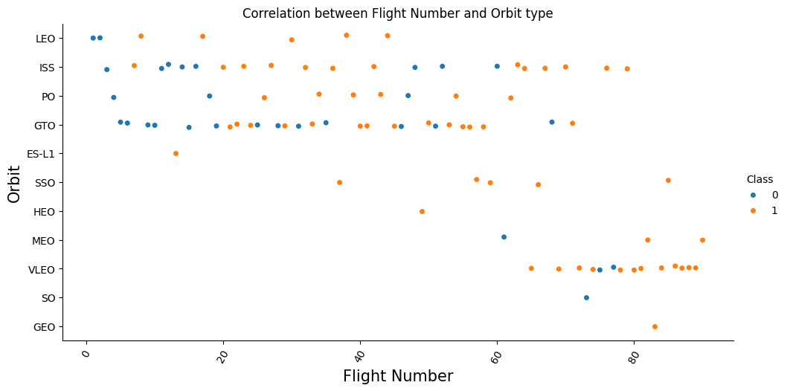
Flight Number vs. Orbit Type
Orbits which are:
Used Most Frequently:
GTO (27 flights)
ISS (21 flights)
Used Most Frequently in Recent Times:
VLEO (14 flights)
Used Only Once:
ES-L1
GEO
HEO
SO

Slide 22
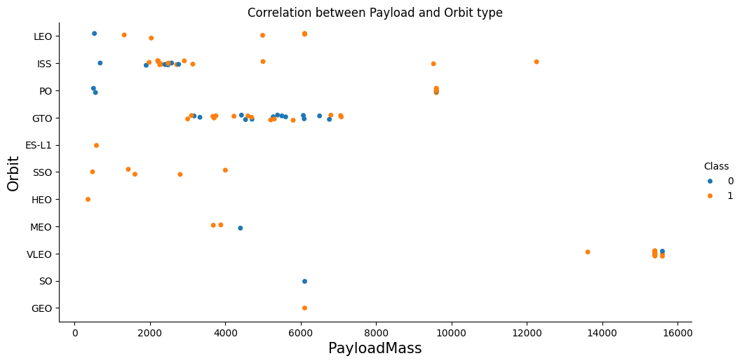
Payload vs. Orbit Type
Orbits which are used for:
Heavy Payloads ( >10000kg ):
VLEO
ISS
Moderate Payloads (5000kg-10000kg):
GTO
PO
SO
GEO
LEO
Light Payloads ( <5000kg ):
SSO
MEO
ES-L1
HEO

Slide 23
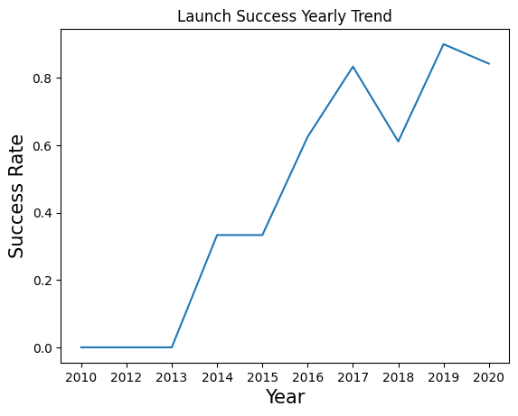
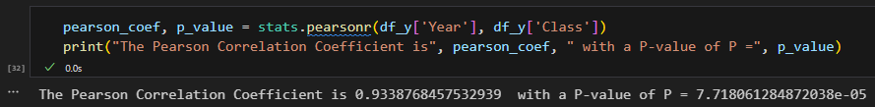
Launch Success Yearly Trend
Year has a highly positive and significant relation with Success Rate.
Pearson Coefficient: 0.9338
P-value: 7.718 × 10⁻⁵
But they have a non-linear relationship.
Most Successful Year: 2019 (90% success)
Most Unsuccessful Years: 2010-2013

Slide 24
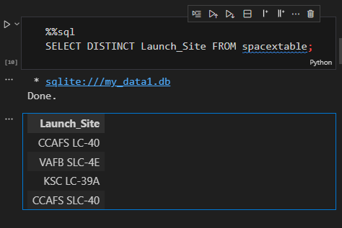
All Launch Site Names
We can get the names of all launch site by:
Querying only the “Launch_Site” column from the database table using SELECT statement.
Getting unique values of launch site names using DISTINCT keyword to remove duplicate entries from all records.
In the output both CCAFS SLC-40 and CCAFS LC-40 are specified but they are the same launch site so data need to be cleaned to fix this.

Slide 25
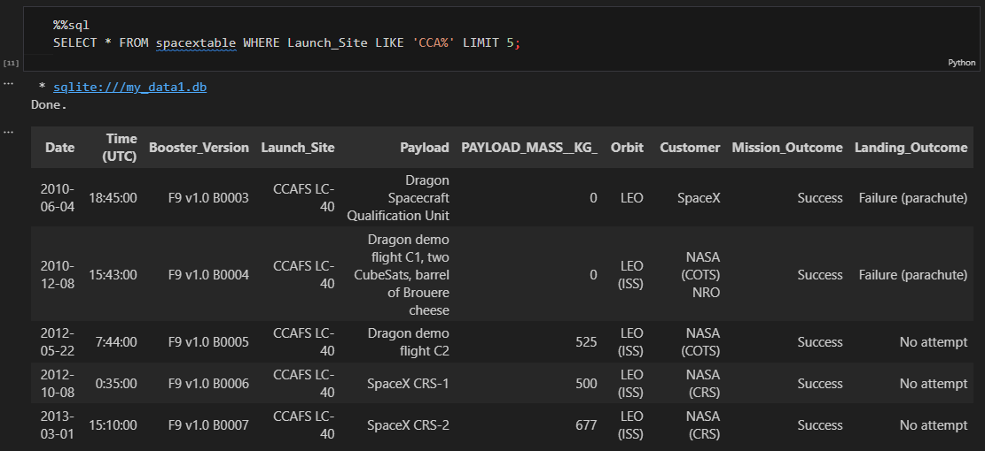
Launch Site Names Begin with 'CCA'

Slide 26
Query:
%%sql
SELECT * FROM spacextable WHERE Launch_Site LIKE 'CCA%' LIMIT 5;
Explanation:
We can get 5 records of site names beginning with “CCA” by:
Querying entire rows using wildcard * from the database table using SELECT statement.
Using LIKE keyword to compare string values in “Launch_Site” column starting with “CCA”.
Filtering the results to have specified LIKE property using WHERE keyword.
Limiting the output records to 5 using LIMIT keyword.

Slide 27
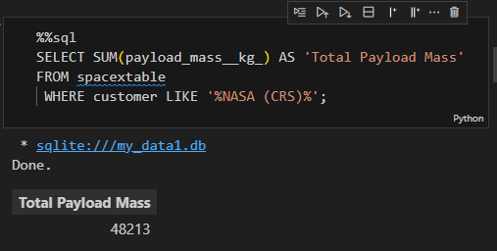
Total Payload Mass
We can get the total payload mass of boosters launched by “NASA (CRS)” by:
Querying sum of only the “payload_mass__kg_” column using SUM aggregate function along side the SELECT statement.
Using LIKE keyword to compare string values in “customer” column having “NASA (CRS)” in it.
Filtering the results to have specified LIKE property using WHERE keyword.

Slide 28
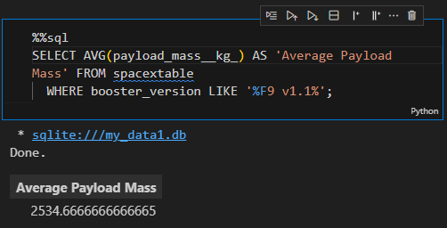
Average Payload Mass by F9 v1.1
We can find the information mentioned in the title by:
Querying sum of only the “payload_mass__kg_” column using AVG aggregate function along side the SELECT statement.
Using LIKE keyword to compare string values in “booster_version” column having “F9 v1.1” in it.
Filtering the results to have specified LIKE property using WHERE keyword.

Slide 29
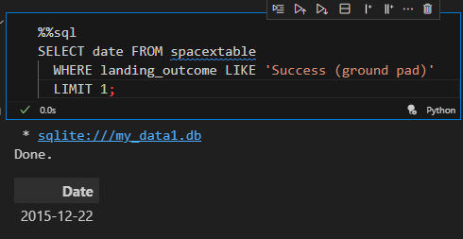
First Successful Ground Landing Date
We can find the information mentioned in the title by:
Querying only the “date” column using SELECT statement.
Using LIKE keyword to compare string values in “landing_outcome” column to be “Success (ground pad)”.
Filtering the results to have specified LIKE property using WHERE keyword.
Limiting output to 1 using LIMIT.

Slide 30
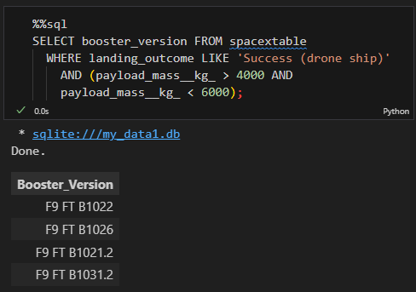
Successful Drone Ship Landing with Payload between 4000 and 6000
We can find the information mentioned in the title by:
Querying only the “booster_version” column using SELECT statement.
Using LIKE keyword to compare string values in “landing_outcome” column to be “Success (ground pad)” and “payload_mass__kg_” column values to be between 4000 & 6000.
Filtering the results to have specified property using WHERE keyword.

Slide 31
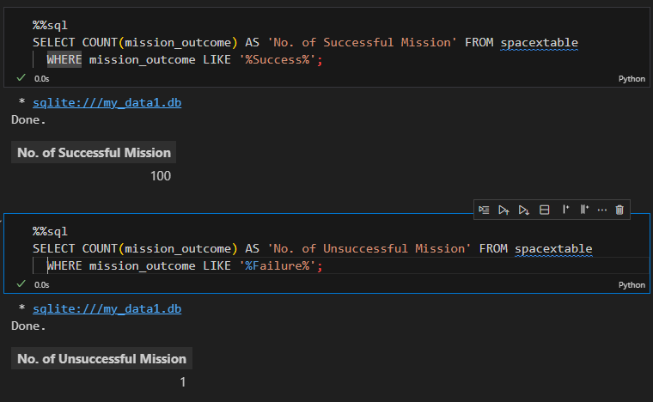
Total Number of Successful and Failure Mission Outcomes
We can find the information mentioned in the title by:
Querying count of only the “mission_outcome” column using COUNT aggregate.
Using LIKE keyword to compare string values in “mission_outcome” column to have “Success” & “Failure” in it.
Filtering the results to have specified LIKE property using WHERE keyword.

Slide 32
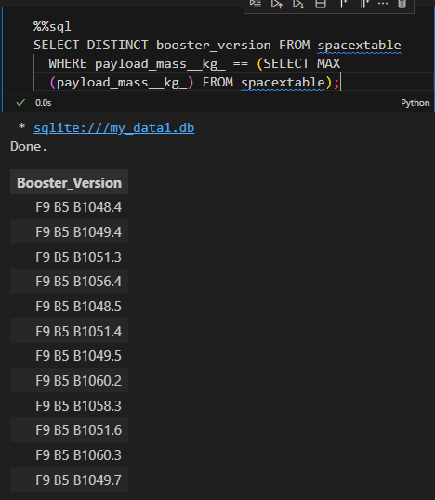
Boosters Carried Maximum Payload
We can find the information mentioned in the title by:
Querying only unique values in the “booster_version” column using DISTINCT keyword.
Filtering the results using WHERE keyword to have maximum “payload_mass__kg_” using MAX in subquery.

Slide 33
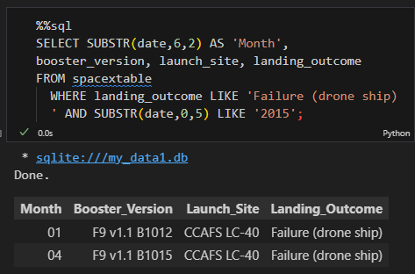
2015 Launch Records

Slide 34
Query:
%%sql
SELECT SUBSTR(date,6,2) AS 'Month', booster_version, launch_site, landing_outcome FROM spacextable WHERE landing_outcome LIKE 'Failure (drone ship)' AND SUBSTR(date,0,5) LIKE '2015’;
Explanation:
We can list the failed landing_outcomes in drone ship, their booster versions, and launch site names for in year 2015 by:
Querying only month part of date using SUBSTR along side other mentioned columns using SELECT.
Using LIKE keyword to compare string values in “landing_outcome” column be “Failure (drone ship)” and substring of date containing year to be “2015”.
Filtering the results to have specified property using WHERE keyword.

Slide 35
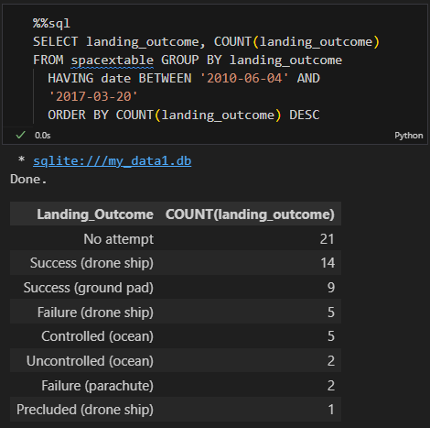
Rank Landing Outcomes Between 2010-06-04 and 2017-03-20

Slide 36
Query:
%%sql
SELECT landing_outcome, COUNT(landing_outcome) FROM spacextable GROUP BY landing_outcome HAVING date BETWEEN '2010-06-04' AND '2017-03-20’ ORDER BY COUNT(landing_outcome) DESC
Explanation:
We can rank the count of landing outcomes (such as Failure (drone ship) or Success (ground pad)) between the date 2010-06-04 and 2017-03-20, in descending order
by:
Querying only landing_outcome column and its count using COUNT aggregate function.
Grouping the results according to landing_outcome.
Filtering the results using WHERE to have date in between specified date using BETWEEN.
Presenting the filtered result in descending order on the basis of COUNT(landing_outcome) using ORDER BY keyword.

Slide 37

Section 3

Slide 38
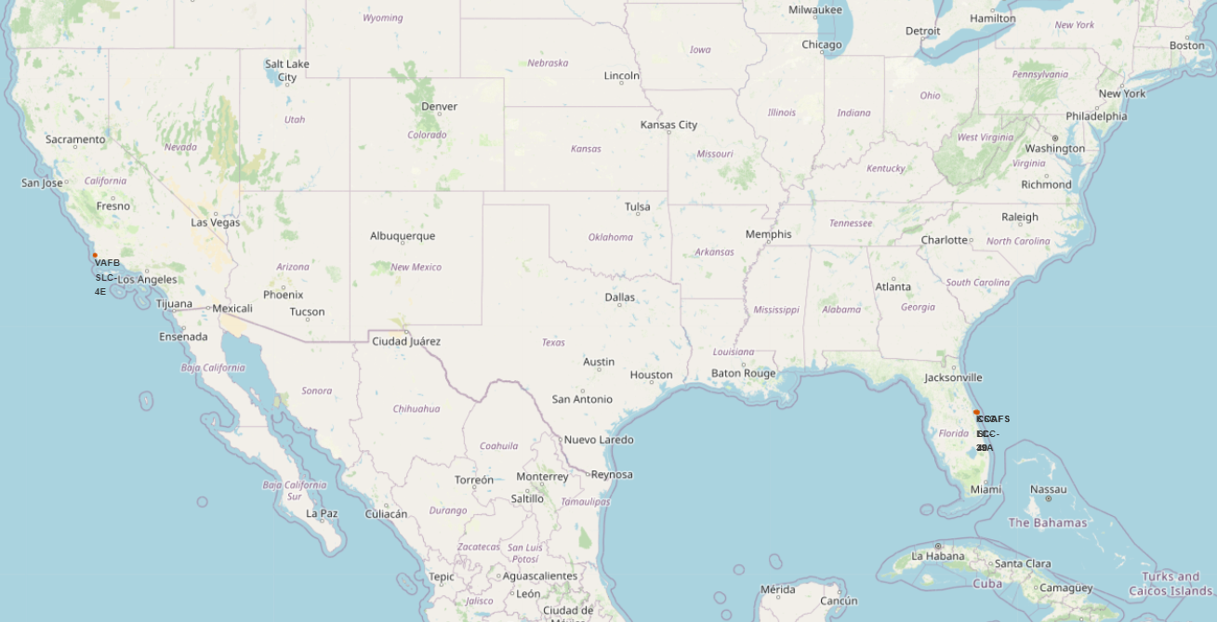
Map showing all Landing Sites
In the given figure sites are highlighted in orange and we can see that:
They are all located near costal regions of the U.S. which allows rockets to land on water and reduces damage in case of failure.
They are all located near the equator line because the linear velocity of Earth's surface is greatest towards the equator which is advantageous for launching rockets.

Slide 39
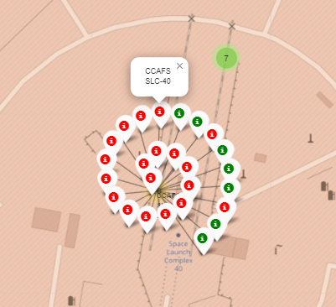
Map marking launch success & failures in each site
In the given figure we can see that:
CCAFS SLC-40 launch site has more failures that success.
Thus, the colored markers in marker cluster makes identifying launch sites success rate easier.

Slide 40
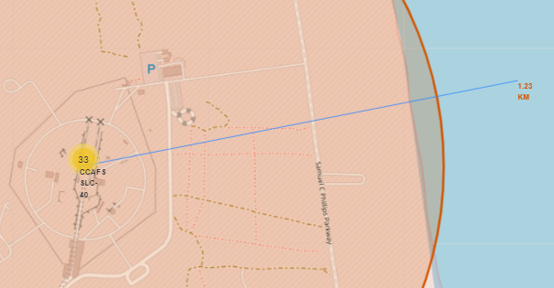
Map of a launch site in proximity to coastline
In the given figure we can see that:
A blue line highlighting a path from CCAFS SLC-40 launch site to nearest coastline.
The distance between the launch site and nearest coastline. i.e. 1.23km highlighted in orange.

Slide 41

Section 4

Slide 42
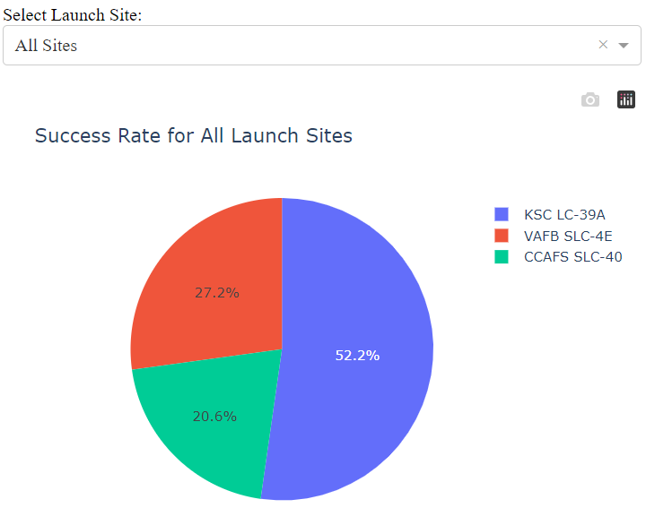
Success count for all Launch Sites
The given pie chart shows the contribution of each launch site toward total successful launches:
KSC LC-39A is the most successful launch site contributing to 52.2% of all successful missions.
CCAFS SLC-40 is the least successful launch site.
72.6% of successful missions were launched from Florida as KSC LC-39A and CCAFS SLC-40 both are within it.
Note:
Data was cleaned to replace CCAFS LC-40 with CCAFS SLC-40 because they both are the same launch site.

Slide 43
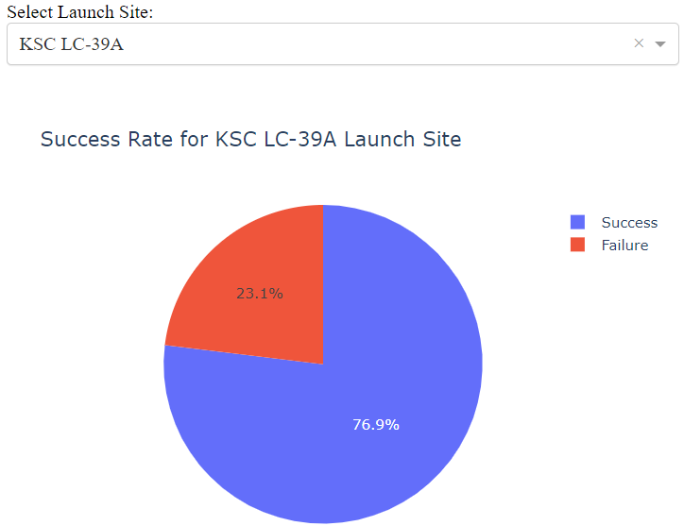
Launch Site with Highest Launch Success Ratio
The given pie chart shows the success rate of KSC LC-39A launch site as:
KSC LC-39A has the highest launch success rate of 76.9%.
Consequently, it’s failure rate is 23.1%.

Slide 44
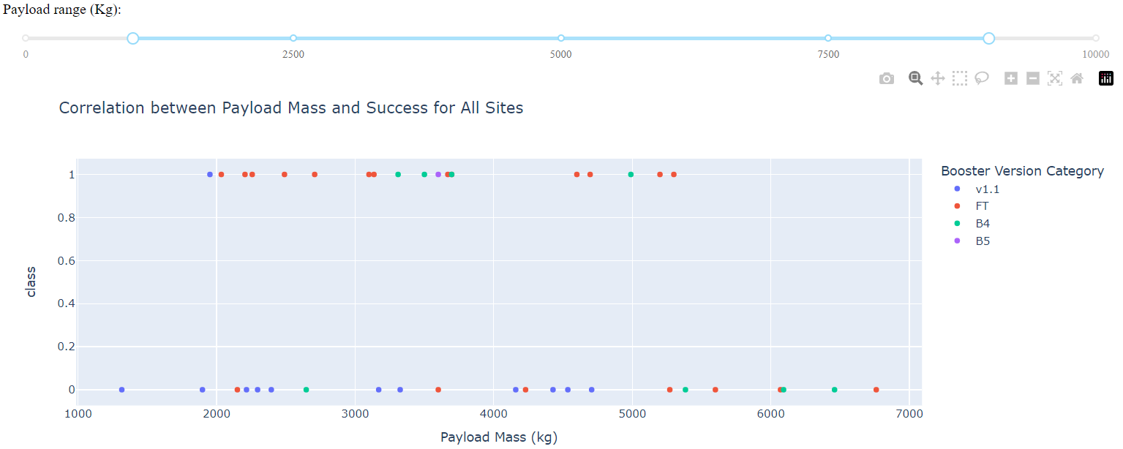
Correlation between Payload Mass & Success for all sites
Most Successful Booster Version: FT
Least Successful Booster Version: v1.1
Most Successful Payload Mass Range: 3100kg – 3700kg (7 success)
Least Successful Payload Mass Range: 4100kg – 4800kg (5 failure)

Slide 45

Section 5

Slide 46
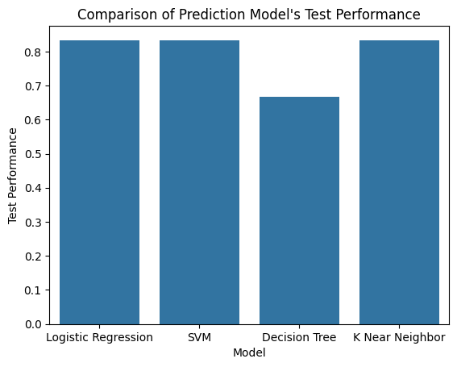
Classification Accuracy
The given bar chart shows the prediction accuracy of various Machine Learning models using new testing data set.
The Decision Tree classifier scored lowest with accuracy of 66.6% due to its inability to fit all training data.
All other prediction models performed the same with testing accuracy of 83.3%.

Slide 47
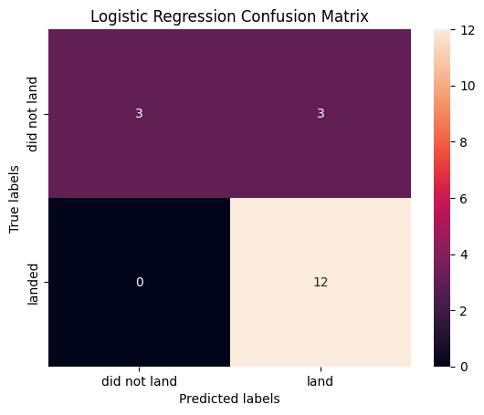
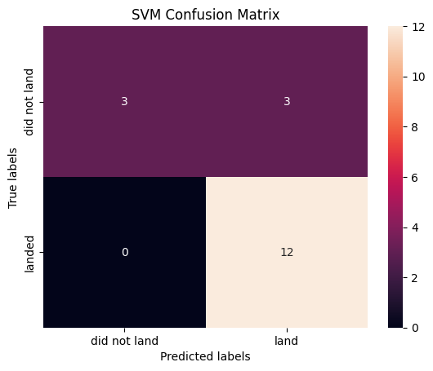
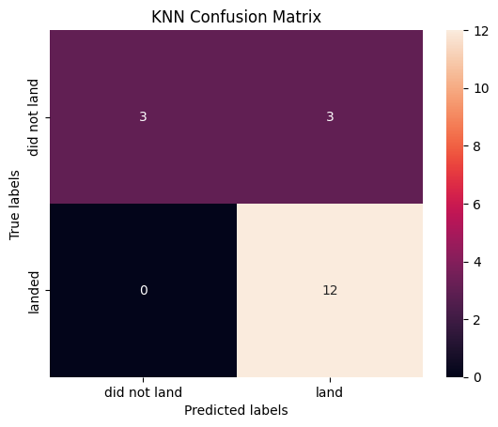
Confusion Matrix
Even the confusion matrices are same for all three best models.

Slide 48
Conclusions
Year has a highly positive and significant but non-linear relation with Success Rate.
The increase in success rate which seemed due to increase in flight number and the added experiences that come with it, also seem to be heavily influenced by the use of VLEO orbit and its high success rate.
The positive relation between success rate and weight might be due to VLEO orbit due to its high no. of flights with high payload weight.
All landing sites are located near the equator line because the linear velocity of Earth's surface is greatest towards the equator which is advantageous for launching rockets.
72.6% of successful missions were launched from Florida as KSC LC-39A and CCAFS SLC-40 both are within it.
KSC LC-39A has the highest launch success rate of 76.9% and contributes to 52.2% of all successful missions.
“FT” is the most successful booster version where as “v1.1.” is the least successful.
3100kg to 3700kg is the most successful payload mass where as 4100kg to 4800kg is the least successful.

Slide 49


